Slide 1
How to get a good sleep?
Shan Jiang

Slide 2
content
1.
MISINFORMATION
2.
TAKE WAY YOUR CELLPHONE
3.
RELEASE PRESSURE

Slide 3
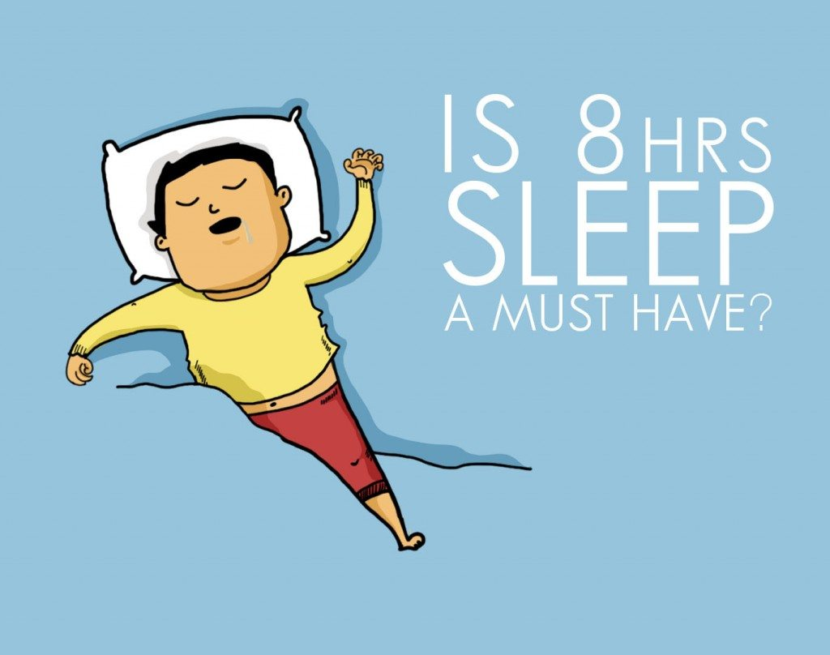
“Everyone needs eight hours of sleep a night”?
“8” is an average goal
Seven and nine hours for adults
Change by age

Slide 4
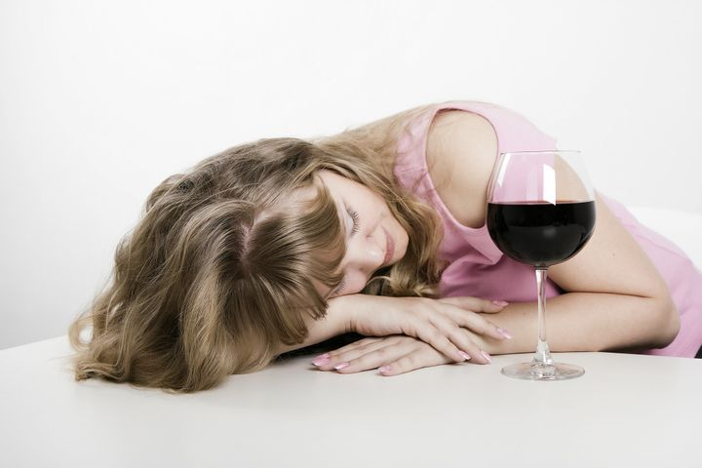
“Take a wine before sleep”?
Fall asleep quickly
You won’t sleep as deeply.
Acholo effct REM(Rapid eye movement sleep)
Increases Snoring.

Slide 5
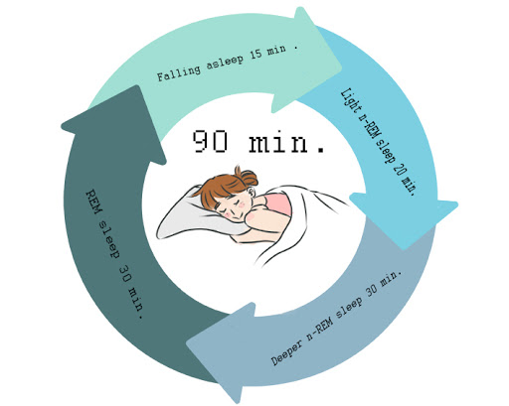
“Get more Sleep on weekend”?
sleep-wake schedules
lead to health issues

Slide 6
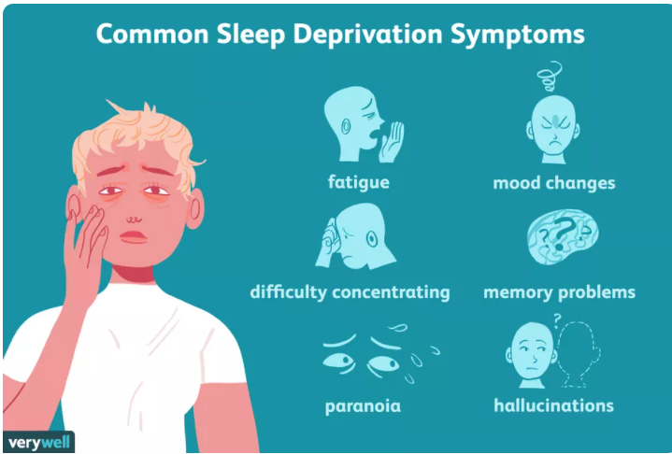
Sleep deprivation
Emotional state
Immune system
.

Slide 7
1.
MISINFORMATION
“Everyone needs eight hours of sleep a night”
“Take a wine before sleep”?
“Get more Sleep on weekend”?

Slide 8
2
TAKE WAY YOUR CELLPHONE

Slide 9
“Take away your cellphone”
Blue light
dopamine
levels of melatonin

Slide 10
3
RELEASE PRESSURE

Slide 11
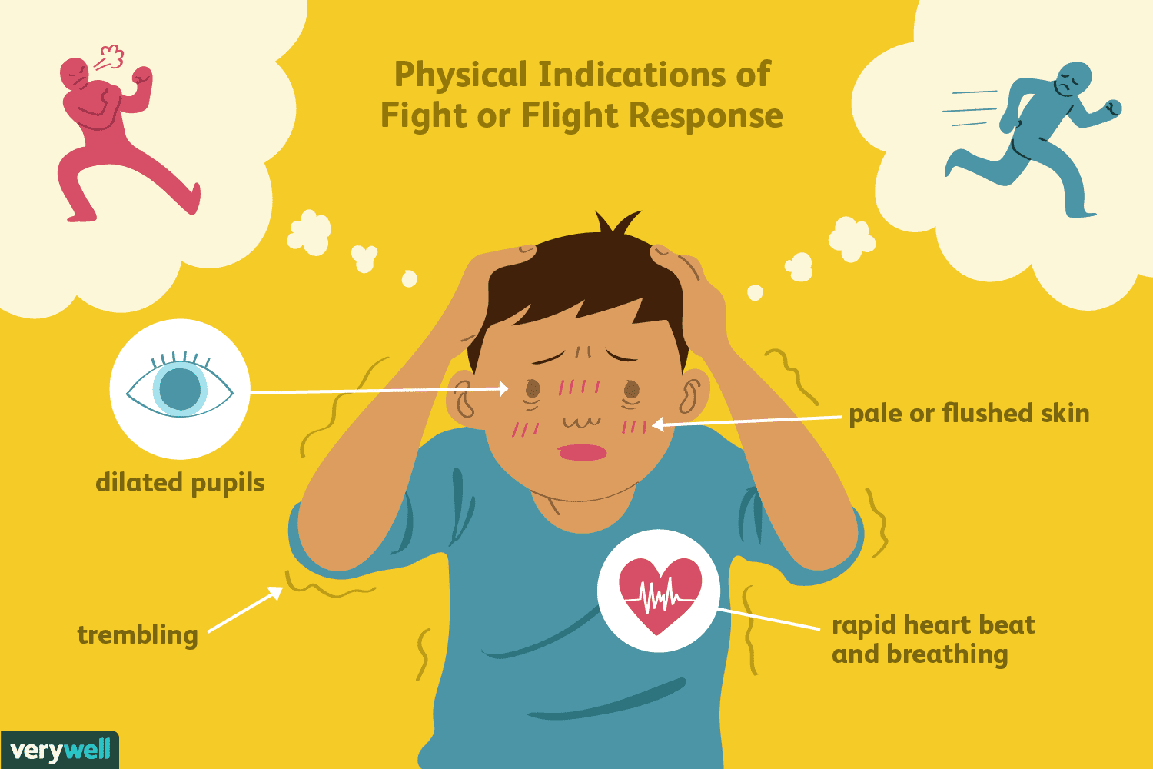
“Release Pressure”
Alertness Levels
Fight or Flight Response System

Slide 12
TIPS
Natural Sunlight
Reduce daytime naps
Exercise

Slide 13
THANK YOU

